Slide 1

Maintaining a Mirrored Database Tips and Tricks by Paul G. Hiles

Slide 2
Who Am I
. Over 19 years of experience
. Programmer, System Administrator, Technical Manger and DBA.
. Have been working with SQL Server since 2000 starting with version 7.0
. Specializes in performance tuning, troubleshooting and High Availably

Slide 3
Purpose and Objectives
Database mirroring is one of a number of High Availability / Disaster Recovery solutions for SQL Server. Database mirroring is performed at the database level so a number of considerations must be made before, during and after a failover.
. Overview of Database Mirroring
. Mirroring Modes
. Client Connection
. Other Tips – Security, Alerts, Jobs
Session Level: Intermediate

Slide 4
Database Mirroring Options
High safety with automatic failover (synchronous)
High safety (synchronous)
High performance (asynchronous)
  Possible data lost

Slide 5
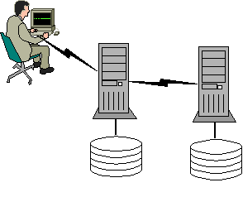
High-Safety Mode
Transaction received from client
Data written to Principal database and log
Data sent to the Mirrored server
Data written Mirror database
Acknowledgement to Principal database
Committed on Principle
Acknowledgment sent to client
1
3
7
5
2
6
4
Principal DB
Mirrored DB

Slide 6
High-Performance Mode
Transaction received from client
Data written to Principal database and log
Committed on Principle
Acknowledgment sent to client
Data sent to the Mirrored server
Data written Mirror database
1
5
4
2
3
6
Principal DB
Mirrored DB

Slide 7
Database Mirroring Options
 | High-Safety | High-Performance
Automatic Failover (w/witness) | Yes | No
Performance Impact | Yes | No
No Data Lost on Failover | Yes | No
Mirror Across a WAN | Maybe | Yes

Slide 8
Client Connection
With High-Safety Mode and a Witness Server, clients will failover seamlessly.

Slide 9
Client Connection
With High-Safety Mode and a Witness Server, clients will failover seamlessly. (Almost)
  Requires the SQL Native Client
  Specify both the Principal and Mirror Servers
  Application must reconnect when a database disconnect occurs

Slide 10
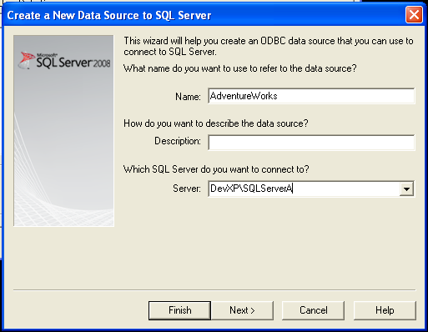
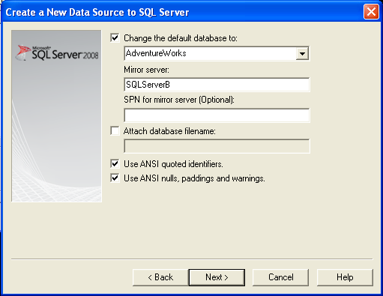
Client Connection
Sample Connection String
  "Data Source=ServerA;Failover Partner=ServerB;Initial Catalog=AdventureWorks; “
ODBC Setup

Slide 11
Client Connection
DEMO

Slide 12
Since mirroring is at the Database level, what is not duplicate / transfers when a failover occurs?
  Master Database
    Security
  MSDB Database
    Agent setup (Jobs, Alerts, Maintenance Plans, Operators …)
    Backup setup / information

Slide 13
Servers Security
Windows Authentication
  Logins need setup on both Servers
  Must be a domain account
  Login_id – Match by default
SQL Server Authentication
  Create the Logins on one server
  Copy Logins between servers (MS Article ID: 246133)
  Login_id – Will not match unless logins are copied

Slide 14
Servers Security
DEMO

Slide 15
Failover Considerations
Connections to the Mirrored (Recovering) Database
  Database inaccessible
Effect
  Alerts / Jobs
  User Connections
  3rd Party Monitoring tools

Slide 16
Servers Setup Considerations
Setup needs to be performed on both Servers
  Jobs
  Alerts
  Operators
  Maintenance Plans
  SQL Mail
  System databases cannot be mirrored

Slide 17
Servers Setup Considerations
Maintenance Plans
  Must be setup on both servers
  Database must be open to create the plans
Recommendation
  Use customer database maintenance via T-SQL scripts

Slide 18
Mirroring State Change Alert
Mirroring State Change Alert
  Triggers a Job
    Disable / Enable Jobs
    Disable / Enable Alerts
    Execute job on both servers
Job / Alert Names
  Contain DB Name

Slide 19
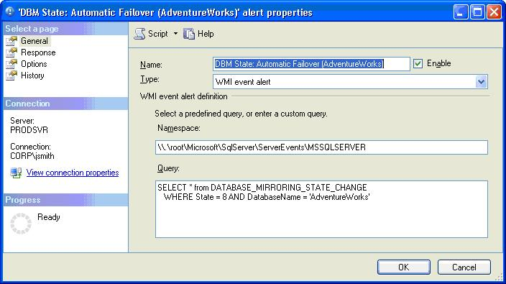
Mirroring State Change Alert

Slide 20
Mirroring State Change Alert
DATABASE_MIRRORING_STATE_CHANGE Status:
  0 = Null Notification
  1 = Synchronized Principal with Witness
  2 = Synchronized Principal without Witness
  3 = Synchronized Mirror with Witness
  4 = Synchronized Mirror without Witness
  5 = Connection with Principal Lost
  6 = Connection with Mirror Lost
  7 = Manual Failover
  8 = Automatic Failover
  9 = Mirroring Suspended
  10 = No Quorum
  11 = Synchronizing Mirror
  12 = Principal Running Exposed
  13 = Synchronizing Principal

Slide 21
Mirroring State Change Alert
Namespace
  Default Instance : \\.\root\Microsoft\SqlServer\ServerEvents\MSSQLSERVER
  Named Instance
  \\.\root\Microsoft\SqlServer\ServerEvents\<instance name>
Query
  SELECT * from DATABASE_MIRRORING_STATE_CHANGE
  WHERE state = 8 AND DATABASE=‘<DBNAME>’

Slide 22
Mirroring State Change Alert
DEMO

Slide 23
Database Mirroring Summary
Test Application to determine how they will handle a failover
Consider the type of mirroring configuration
  Performance vs. safety
Server Setup
  Security
  Jobs, alerts, database maintenance

